Slide 1

Consumer Goods
Ad-Hoc Analysis
AtliQ Hardware
👤 Presented by: Varun Tawsalkar 🛠️ Tools Used: SQL
🔗 Links: 🐙 GitHub 🌐 Portfolio 💼 LinkedIn

Slide 2



AtliQ Hardware
AtliQ Hardware is one of the leading computer hardware producers in India and well expanded in other countries too.
AtliQ sells products in different segments like
Peripherals and Accessories,
PC
Network and Storage and in Platforms like
Brick & Mortar (Chroma , Best buy)
E-Commerce (Amazon, Flipkart)
However, the management noticed that they do not get enough insights to make quick and smart data-informed decisions. So, I have done Ad-Hoc analysis to provide insights to management in consumer goods domain.

Slide 3
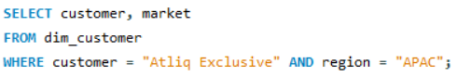
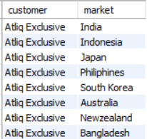
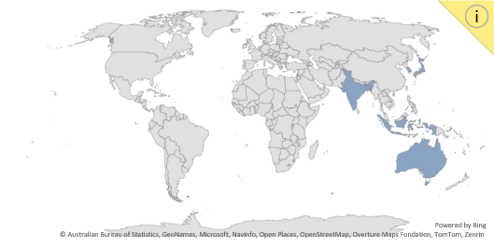
Ad Hoc Requests
1.Provide list of markets in which customer "AtliQ Exclusive"operates its business in APAC region
AtliQ Exclusive operates in 8 different markets in Asia Pacific region Note :APAC stands for Asia-Pacific

Slide 4
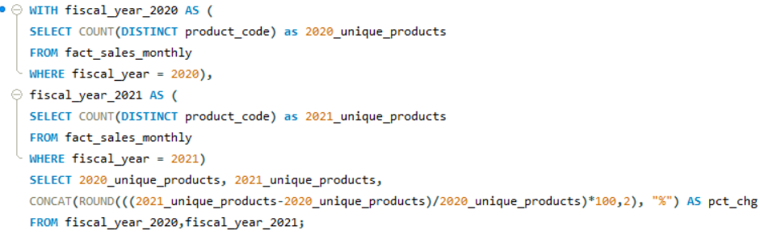
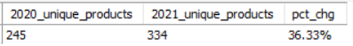
2.What is the percentage of unique product increase in 2021 vs. 2020?
There is a 36.33% increase in unique products from 2020 to 2021.
This growth could be a positive indicator for business performance, signaling innovation or market adaptation.

Slide 5
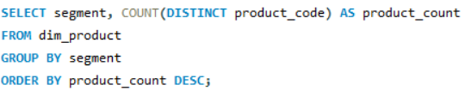
3.Provide a report with all the unique product counts for each segment and sort them in descending order of product counts
Notebook is the leading segment with 129 unique products, indicating a demand in this category.
Networking and Storage have the lowest counts, which may indicate limited offerings or specialization in these areas

Slide 6
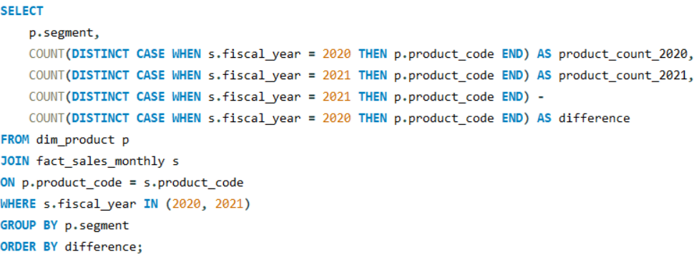
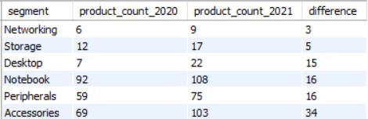
4.Which segment had the most increase in unique products in 2021 vs 2020?
Accessories segment had the most significant increase in unique products. Networking segment showed the lowest increase in unique products

Slide 7
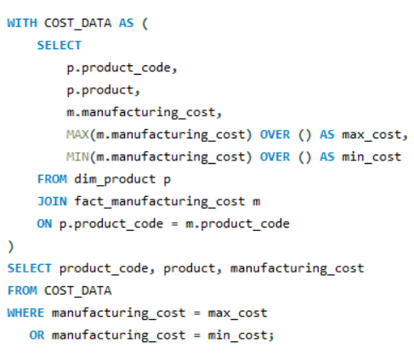
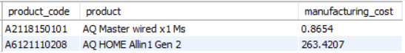
5.Get the products that have the highest and lowest manufacturing costs.
Highest (Personal Desktop)
Lowest (Mouse)

Slide 8
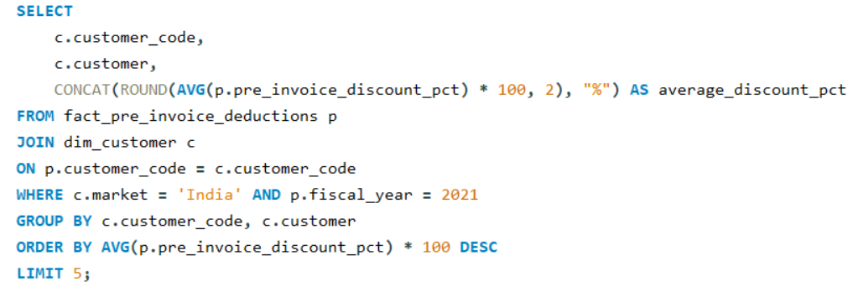
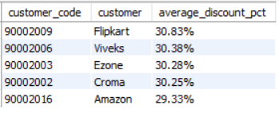
6.Generate a report which contains the top 5 customers who received an average high pre_invoice_discount_pct for fiscal year 2021 and in the Indian market
Flipkart customer was given highest average pre-invoice discount in India in FY2021

Slide 9
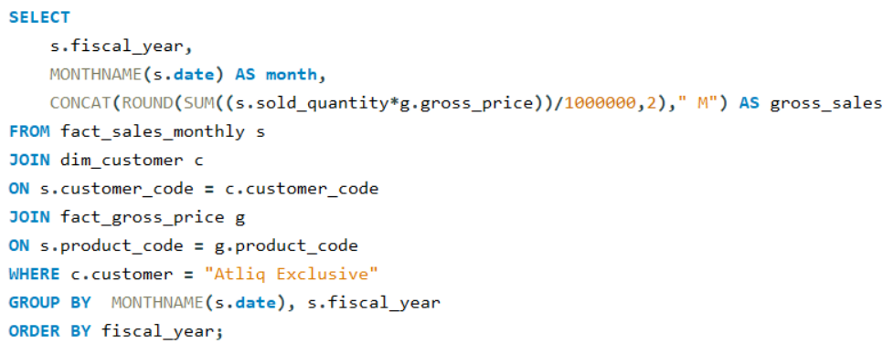
7.Get the complete report of the Gross sales amount for the customer “Atliq Exclusive” for each month.
Gross sales increased significantly from FY 2020 to 2021, with November having peak sales of
$62.3 Millions in FY 2021

Slide 10
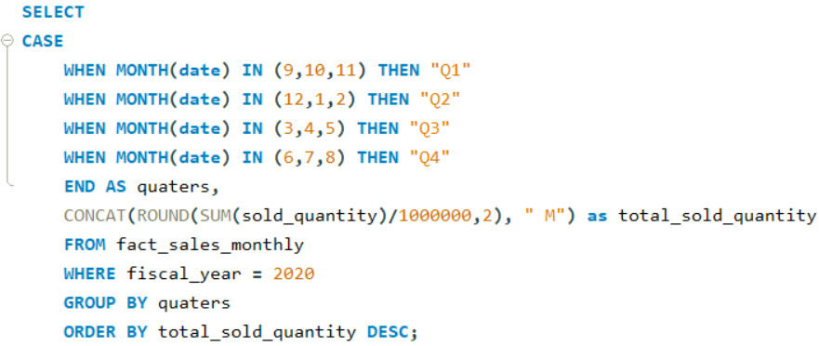
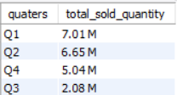
8.In which quarter of 2020, got the maximum total_sold_quantity?
This suggests a strong start in total products sold in Quarter1, followed by a gradual decline over subsequent quarters. While Quarter3 sold least number of products.

Slide 11
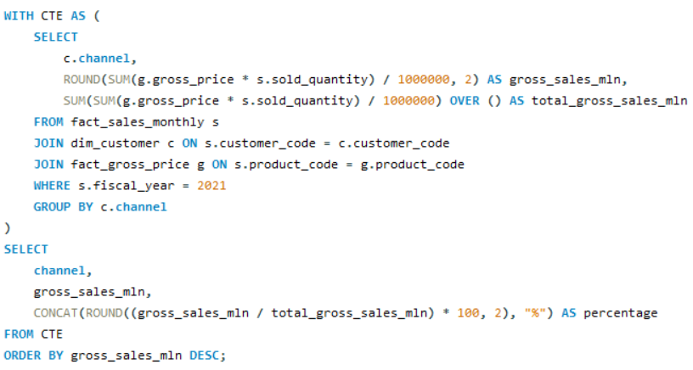
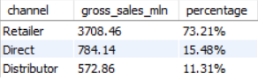
9.Which channel helped to bring more gross sales in fiscal year 2021 and the percentage of contribution?
The Retailer channel generated the highest gross sales
with 73.21% of total sales in FY2021

Slide 12
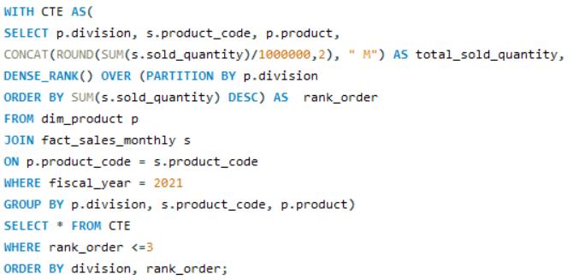
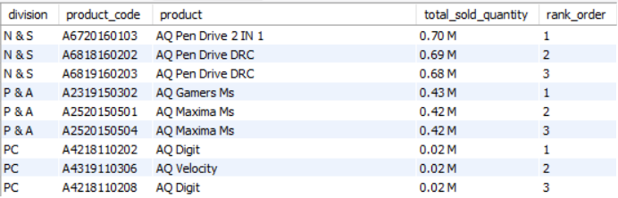
10.Get Top 3 products in each division that have a high total_sold_quantity in the fiscal_year 2021

Slide 13

AtliQ Hardware
Thank You

